Slide 1


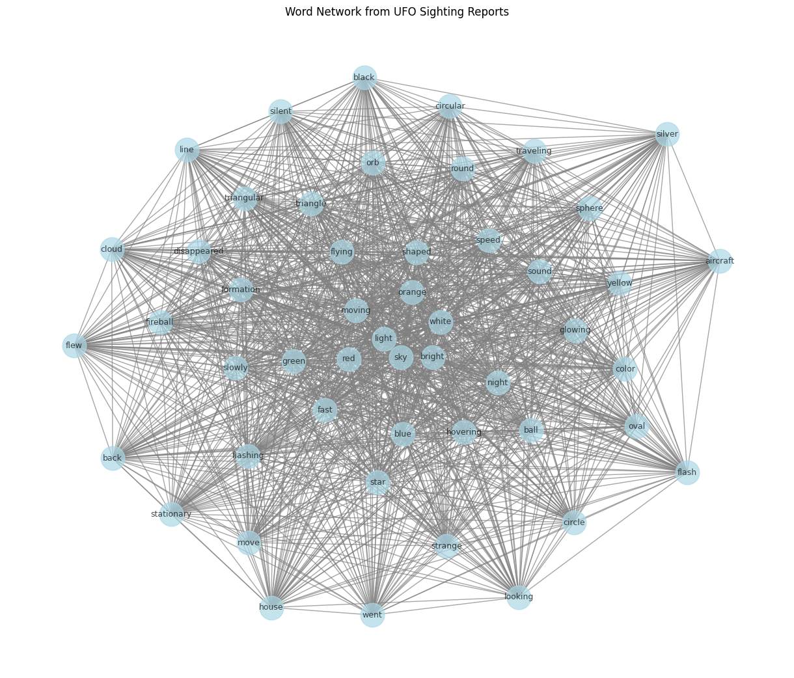
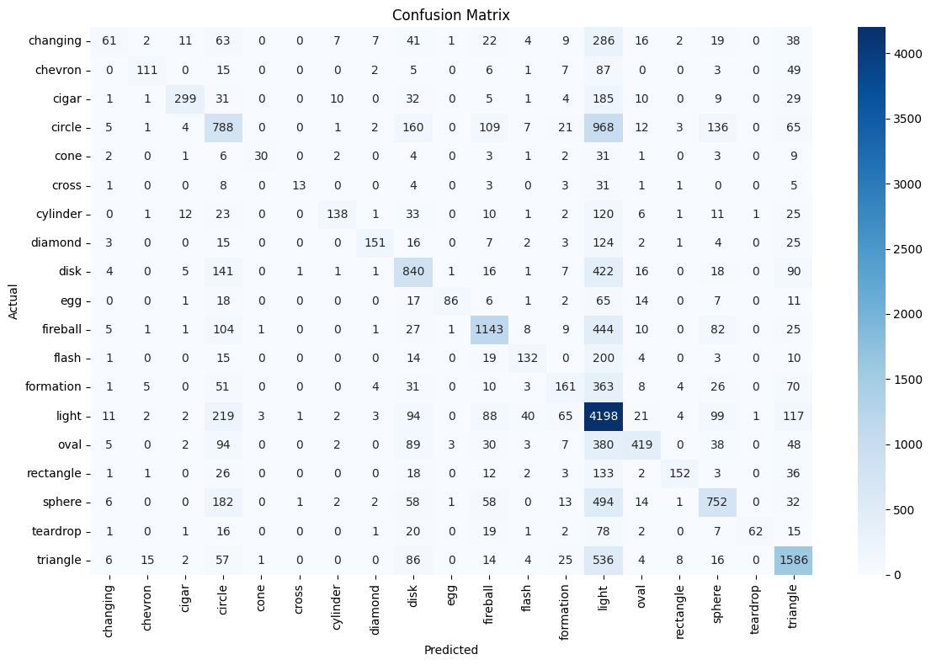

Uncovering Patterns in UFO Sightings
Topic Modeling and Network Analysis of Encounter Descriptions
INTRODUCTION
UFO sighting reports contain many real stories written by people who saw strange things in the sky.
We wanted to understand two main things:
What common themes appear in these reports?
How are the words and ideas connected to each other?
We used two methods:
Topic Modeling
This finds groups of words that often appear together. It helps discover hidden themes such as “bright lights in the sky” or “triangular objects”.
Network Analysis
This shows how words are connected to each other. It creates a network where strongly related words are linked together.
Why these two?
Topic Modeling shows the main topics.
Network Analysis shows how the words inside those topics are connected.
Together they give a clear picture of the patterns in UFO reports.
LIS 4/5693: Information Retrieval and Text Mining
Nathan Bratzler / Diego Macedo
University of Oklahoma
METHODOLOGY
Topic Modeling
Used Bag-of-Words and Latent Dirichlet Allocation (LDA) to find recurring patterns of co-occurring words.
Network Analysis
Built a word co-occurrence network to show connections between words that appear together in the same report.
Built a model to predict UFO shape from the description text using TF-IDF (Term Frequency-Inverse Document Frequency),
CONCLUSION
• Topic modeling revealed clear themes such as bright lights and triangular shapes.
• Network analysis showed strong connections between words like “light”, “sky”, and “object”.
• The machine learning model could predict some UFO shapes from the text. Text mining helps us find meaningful patterns in large collections of UFO stories.
FINDINGS
REFERENCES
Chapter 5: Text Clustering and Topic Modeling
Text Pre-Processing chapter
Text Visualization module (Altair)
GitHub Repository
Dataset
https://shorturl.at/46KIb
DATA
We used thousands of real UFO sighting reports.
Each report has a long description column written by eyewitnesses.
This gives more than 1,000 text documents with categories (ufo_shape).Text Preprocessing
We cleaned the descriptions by:
Making all letters small
Removing punctuation and numbers
Removing common words like “the”, “and”, “of”
Changing words to their simple form
Figure 1: Word Network
Figure 2: Confusion Matrix
MODEL PERFORMANCE
Metric | Score
Model Used | Logistic Regression
Accuracy | 55.2%
Macro Average F1-Score | 0.49
Weighted Average F1-Score | 0.54
Total Test Samples | 20,146
Number of UFO Shapes Predicted | 19
The model correctly predicted the UFO shape 55% of the time using only the text description.

